Slide 1
Individual sales dataset
Name = Anukriti
Student Id = 0775876

Slide 2
Abstract
We have selected Sales Data from sales datasets. This dataset includes about 40,000 records and 15 attributes. Each record corresponds to a customer information like (gender, education, house Value, age, region, fam income, region, marriage, children, occupation, car probability, house own, flag (whether the customer purchased the target productor not) and online (whether the consumer had online shopping experience or not). This dataset provide helps to organizations to better understand their customers needs and makes it easier for organizations to modify products according to the specific needs, behaviors, and interests of customers. When organizations satisfy customers specific needs according to their demands it helps companies to increase there productive of different products in the entire market and helps to gain more and more profit. Because companies’ whole profit and loss is depending upon customers demand if company fulfill the demand of customers, it definitely gains profit if it do not fulfill need of their customers than it will gain loss. This dataset is uncleaned there are some missing values in the dataset. It contains character and numerical data type. We will use some method to clean our dataset to make it stronger and more valuable to perform different types of models to collect different results. We will also use predictive and descriptive analysis to discuss about how many customers received their products according to their demands and we will also find in which direction company sales trend moved upward or downward.

Slide 3
Research question
find out the customer buy the target product or not By using predictive analysis?
Find out the number of buyers who have online shopping experience or not?
By using descriptive analysis find out Find out number of male and female in the dataset?
Find out sales increase by married or unmarried?
how many customers have highest or lowest family income?

Slide 4
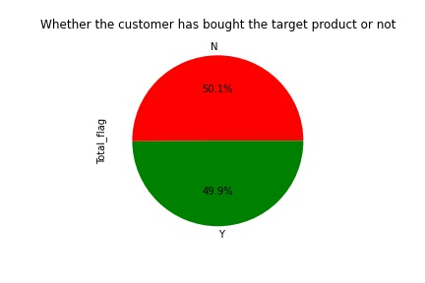
find out the customer buy the target product or not By using predictive analysis?
In this picture the percentage of buyers who bought their target product is denoted by ‘Y’ and the percentage of customer who do not purchase their target products is denoted by ‘N’ and the percentage is approximately same. Due to this result it is crystal clear the company do not have more profit because of half of the customer do not satisfy from the services by company because they do not buy their target product which they want to buy.

Slide 5
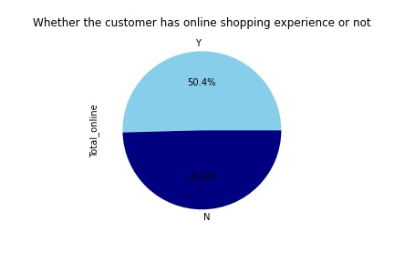
Find out the number of buyers who have online shopping experience or not?
text here
In this illustrated picture the ‘Y’ is consumers who have online shopping experience and ‘N’ who do not have online. It can be clearly found that 50.4% customers have online shopping experience on the other hands 49.6% do not have any online shopping experience.

Slide 6
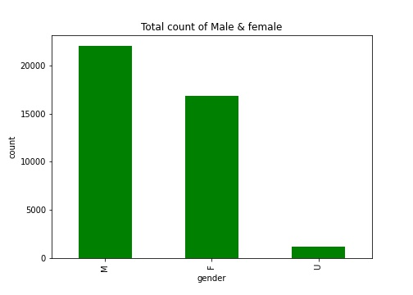
By using descriptive analysis find out Find out number of male and female in the dataset?
It can be clearly seen that ‘M’ is the number of male, F female and U unknowns. It is found that male buy more products count is highest (22500) as compared to other two categories female and unknown. Females lies on second position with (17000) count. After that, I can be accounted some unknown values in these three gender and the count is approximately 150. Unknown comes on last rank.

Slide 7
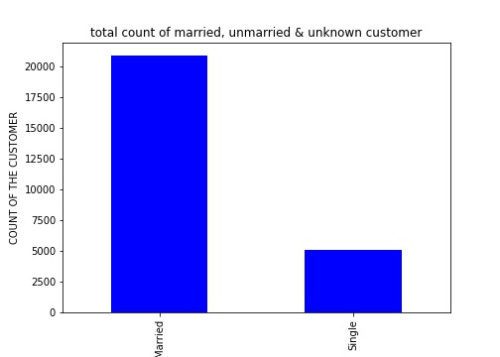
Find out sales increase by married or unmarried?
In this graph it can be see that more people are married and they buy more products from company and because of them company’s sales increases . The count of unmarried customers in this dataset is 500 which is less as compared to married category.

Slide 8
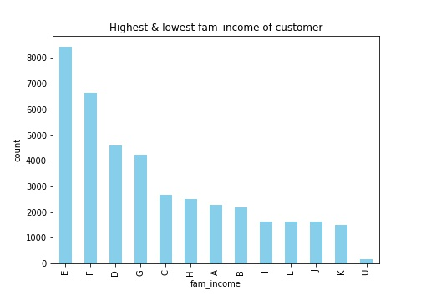
how many customers have highest or lowest family income?
In this bar graph it is crystal clear, there are 13 level of family’s income of customer. The customer of highest income comes in level ‘E’ and the count is 8400.on the others hand, the customer of least family income level comes in the level ‘U’and the count of income is 200.

Slide 9
Tools
Python is use to do all data visualization.

Slide 10
Github account’s link
https://github.com/Anukriti0775876

Slide 11
Methodology
In the initial stage, The dataset is unclean and contain some count of missing values and duplicate values. On the first phase of analysing, cleaning will take place to perform further operations. In this we will use regression model to find out relationship between dependent and independent variables. Descriptive and predictive analysis will also take place to find out how many customers are satisfied related to the sales of individual company’s sales. We will also use classification and clustering In this. we will collect different results related to sales of this data set by using these model.

Slide 12
Detailed Data Dictionary:
To assigned the correct datatype and to check the categorical attribute I take one variable . After that I check the number of levels in every attribute and also count Its values corresponding to each level.
There I used five number summary and it is mean, minimum, maximum, count, standard deviation. It use For numerical attributes

Slide 13
Data cleaning
(Duplication of values in the dataset):there are 55 duplicate values in this dataset. the drop duplicated command used for drop these values from data set.
(Missing values in the dataset): The total missing values in this dataset are 18106. House owner have 3369 missing values, There are 735 null values in education attribute, and marriage attribute 14002 missing values. For data cleaning these values are filled by 0.

Slide 14
Train test split method
the whole dataset is separated into two parts which are training and testing sets by using train-test-split method. In which training set have 70% records and testing set have 30% records. Further I apply the under-sampling technique which is use to make the target variable.

Slide 15
Modelling
In the modelling part there are four methods which are as follow:-
1.Logistic Regression
2. KNN
3. Naive Bayes
4. random forest

Slide 16
Logistic Regression: This model is used to predict the value of target variable. It is use to check the probability of target variable.
KNN: The KNN means “K-Nearest Neighbour” :- In this The number of nearest neighbours to a new unknown variable that has to be predicted or classified is denoted by the symbol 'K'.
It is use to check the similarity. It is a machine learning algorithm which can be used to solve classification as well as regression problem statements..
Naive Bayes: It is based on Bayes' Theorem , It can create quick predictors because of it is fast machine learning model. It is use to check the strong independent assumptions between the features.
Random Forest: This is used in Classification and Regression problems. Due to it we can builds multiple decision trees on different samples by the result it can be find that which model is fit by seen accuracy. Which have highest result of accuracy then the model is best fit. In my dataset random forest is the best fit model.

Slide 17
Models
Column1 | Model | Train test split
0 | Logistic Regression | 66.59166667
1 | KNN | 56.98333333
2 | Naive Bayes | 43.06666667
3 | random forest | 66.20833333

Slide 18
K- Fold validation tecnique
The K-Folds operation which is used to minimize the unfairness of the version. It partitioned the dataset into k-folds. On the random state, record is split into 5 folds. The first four folds are use for training and the fifth fold is used for testing. For the looking at a set Repeat it till each fold. At all five outputs are upload to get accuracy and it can be the version's metric of success.
Column1 | Model | Train test split | kfolds_5
0 | Logistic Regression | 66.59166667 | 39.49689
1 | KNN | 56.98333333 | 11.13009
2 | Naive Bayes | 43.06666667 | 14.01036
3 | random forest | 66.20833333 | 50.48972

Slide 19
Stratified K fold
The stratified K fold is do the extension of cross validation technique for classify the problems . The preserving of share of samples in every class use to make the folds in it. In this data is divided in 5 stratified folds. In which, for healthy the version first 4 folds are use, and For further checking 5 fold is consider. Repeat it again and again until each fold have used as a take a look at set. Thereafter add all effects and calculate the common and it can be the version metric.
Column1 | Model | Train test split | kfolds_5 | Stratifiedkfold_5
0 | Logistic Regression | 66.59166667 | 39.496886 | 55.20891182
1 | KNN | 56.98333333 | 11.130088 | 56.22795792
2 | Naive Bayes | 43.06666667 | 14.01036 | 54.53710675
3 | random forest | 66.20833333 | 50.489719 | 65.12576833

Slide 20
Random train test split method
This operation is use to merge the k-fold-cross-validation approach with typical train-test-splits. There the random divides of the information in the training-check set is done by me which is same as the move-validation technique, Thereafter repeating of process take place in splitting and for get the output. Here I divided the statistics into five Repeated Random Test-Train Splits.
Column1 | Model | Train test split | kfolds_5 | Stratifiedkfold_5 | RRTestTrainSplits_5
0 | Logistic Regression | 66.59166667 | 39.49689 | 55.20891182 | 56.0113852
1 | KNN | 56.98333333 | 11.13009 | 56.22795792 | 56.28842505
2 | Naive Bayes | 43.06666667 | 14.01036 | 54.53710675 | 54.08349146
3 | random forest | 66.20833333 | 50.48972 | 65.12576833 | 65.17267552

Slide 21
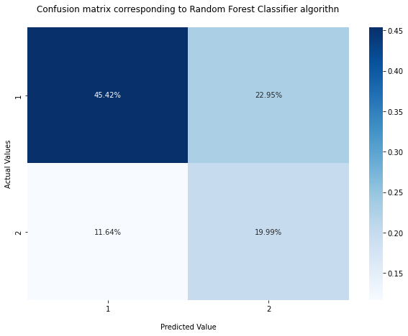
Confusion Matrix
It can be clearly seen that there are two sections actual values and predicted values. If our actual value is 1 and predicted is also 1 then our accuracy is 45.42% and its true. On the other hand if actual value is 1 but predicted is 2 then its false. Afterthat if actual is 2 (11.64%) and predicted is also 2 (19.99%) then its true on the other hand if actual is 2 (11.64%) but predicted is 1 then its false.

Slide 22
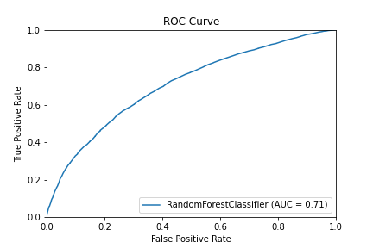
ROC curve
The Receiver operating characteristics is a metric to evaluate classifier output quality. The accuracy is 0.71.In figure 13, area under the curve is accurate

Slide 23
Classification report
Precision – It represents predicted value are true which correspond to target variable
Recall –It reveals actual value that are true which correspond to target variable
F1 score – It is positive class in binary classification of f1 which scores of each class for the multiclass task.
Column1 | precision | recall | f1-score | support
1 | 0.79 | 0.67 | 0.72 | 8193
2 | 0.46 | 0.63 | 0.53 | 3791

Slide 24
conclusion
In conclusion, sales data show zig-zag trend which show 50-50 result. So, I found that half of the buyers get their target product. The random forest is the best fit model because it have the highest accuracy than other.

Slide 25
Recomendation
This data set is all about the sales. If someone wants to make project on it then its best data set because due to it one can get the huge amount of kwoledge about the sales. It is very useful project for upcoming generation.

Slide 26
THANK YOU ☺ ☺

